Slide 1
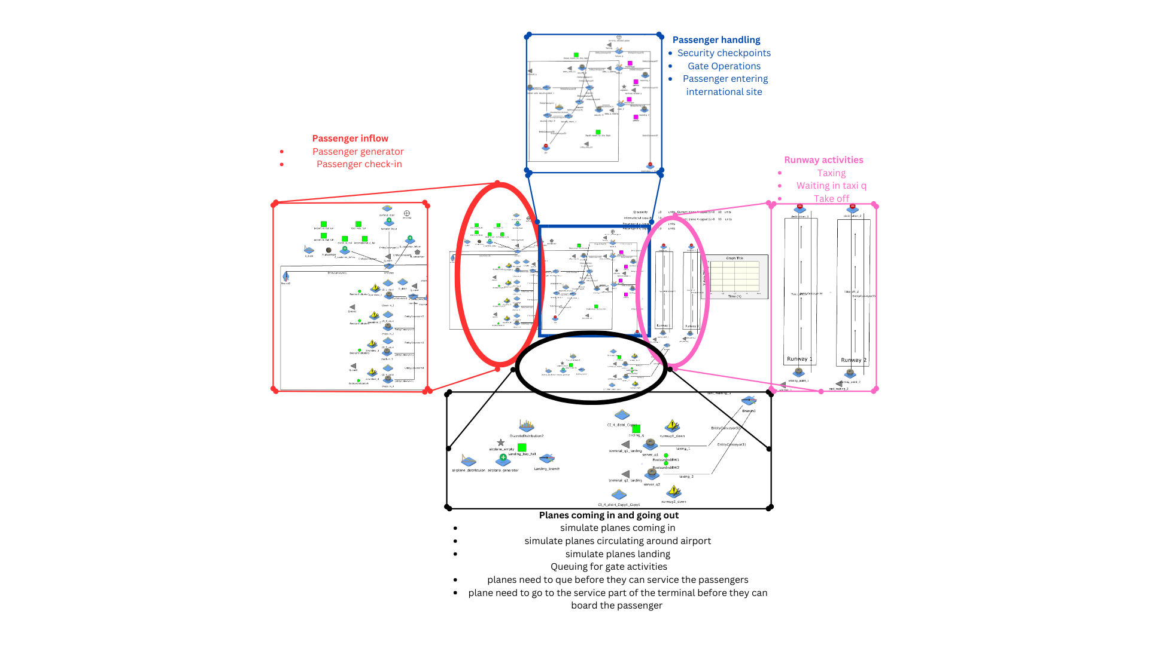

Slide 2
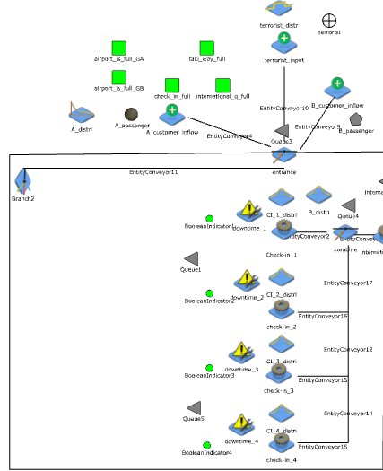
Taxi way, planes that are in the line to take off
Check-In Qs, if the check in Qs is full your airport has hit its capacity
This ensures that the Qs for Gates A and B are not too full. If so, the airport will close till the Q is cleared
If the international Q is full you cannot enter the airport, too many people
Distribution for the check-in to be down, either change of shift or machine is down
Branch2, distributes the people to the shortest Queue
B_distri, is the distribution for the rate of which customers are cleared
Q1 services check-in counters 1 and 2, like a real airport, you have 1 q but multiple counters
This are the check in counters to check in the customers

Slide 3
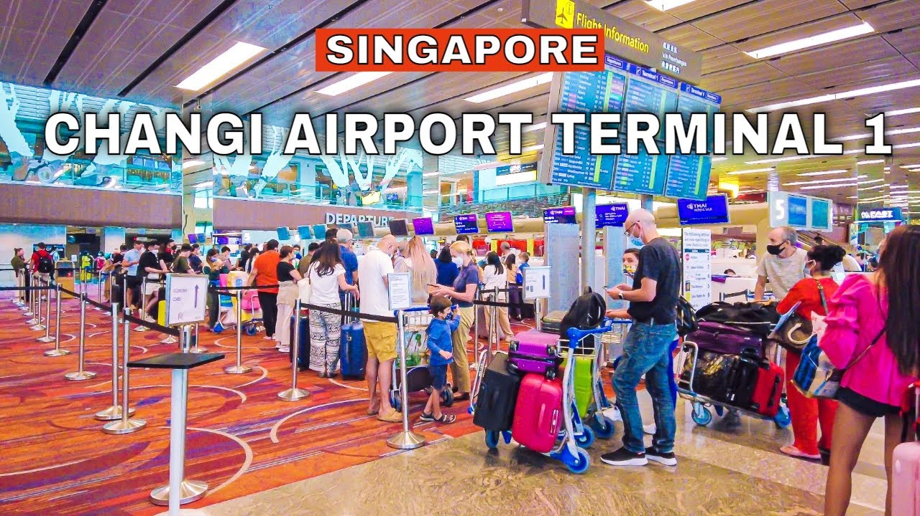
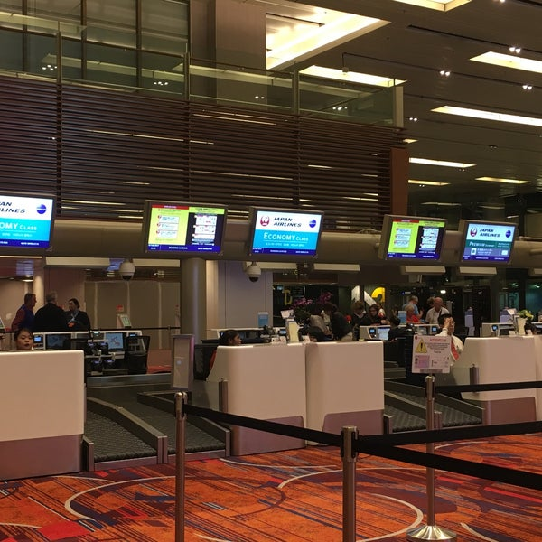

Slide 4
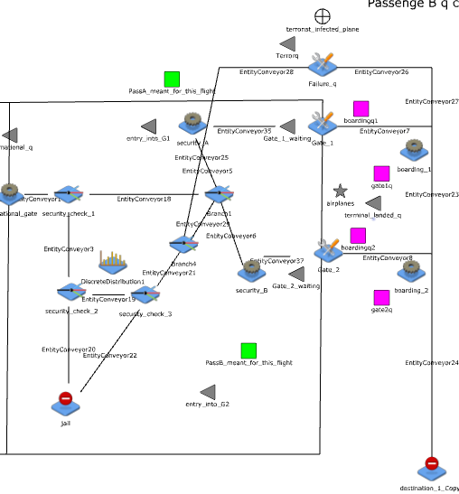
Queue to board the plane or people in the boarding hall
Queue to enter the security A
Security checkpoint
International gate processing function
Boarding function to take all those in the Q, Minimum of 8
Terminal_landed_q, shows all aircrafts that have landed and are ready to enter the gate
This will split terrorist from actual customers
Boarding threshold, will only turn green when there is a plane in the boarding_2, or plane is at the gate, this will allow for boarding to begin
Security threshold that has a capture rate of 95%, security check 1 is surface level and check 2 is bag check
Boarding gate, it’s the function that will relate customer to planes and creates a plane in (boarding time) for rest of the simulation
This will control boarding_2, it will only turn green and allow for plane to approach the gate when the queue_2_waiting or boarding hall is full

Slide 5
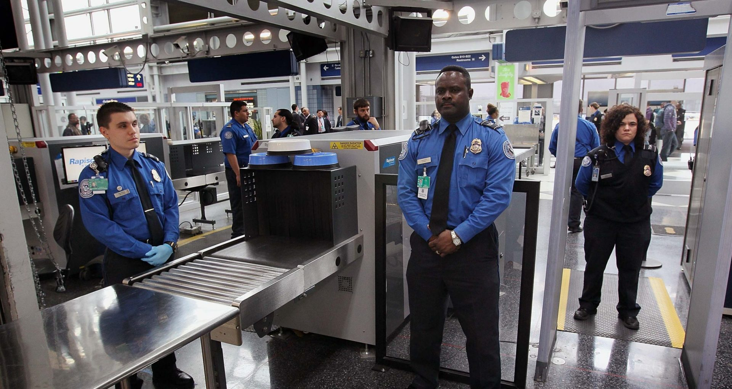
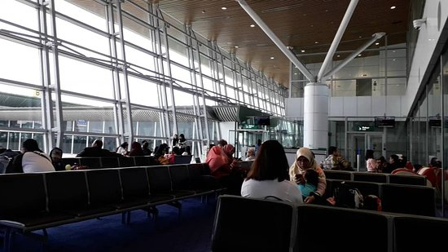
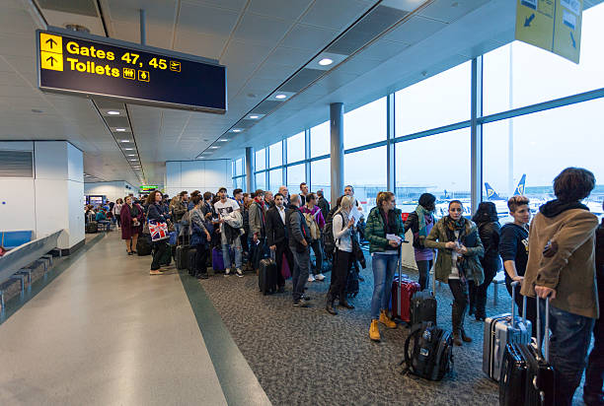
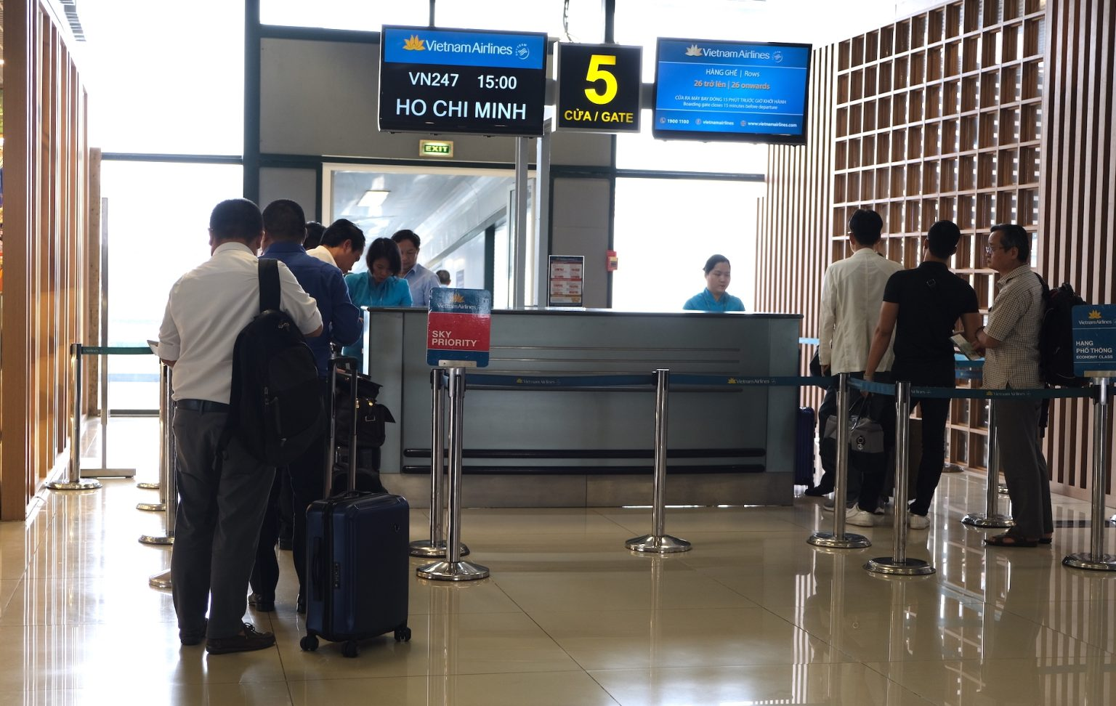
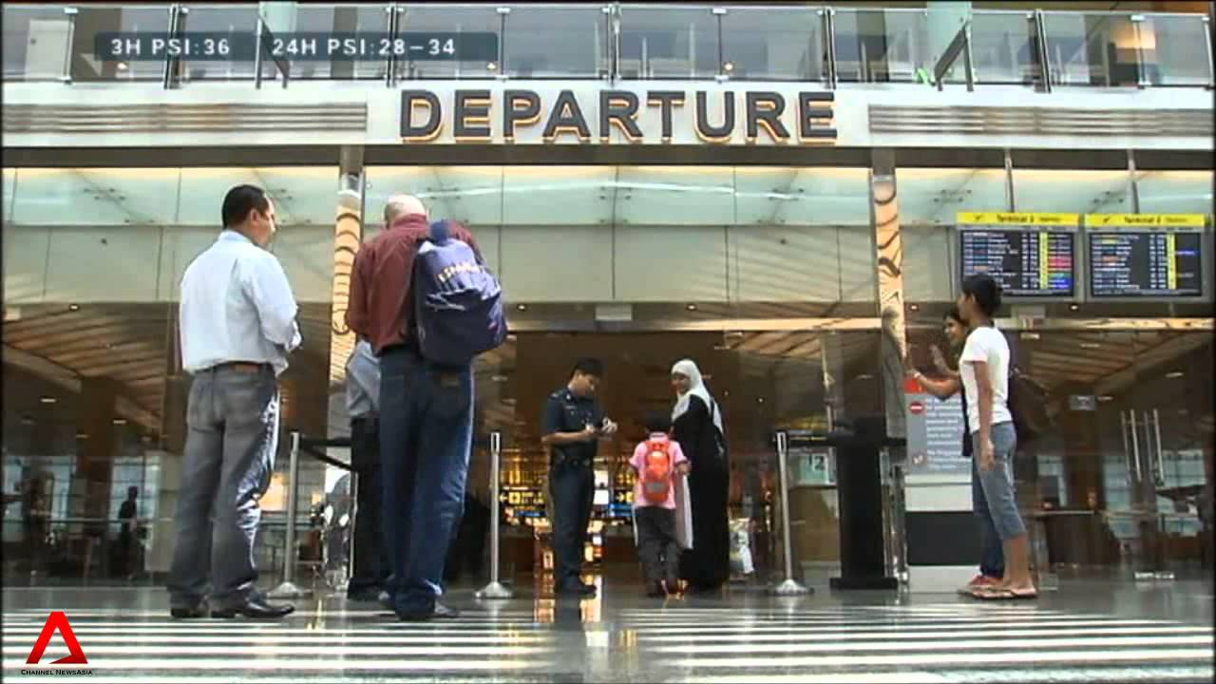
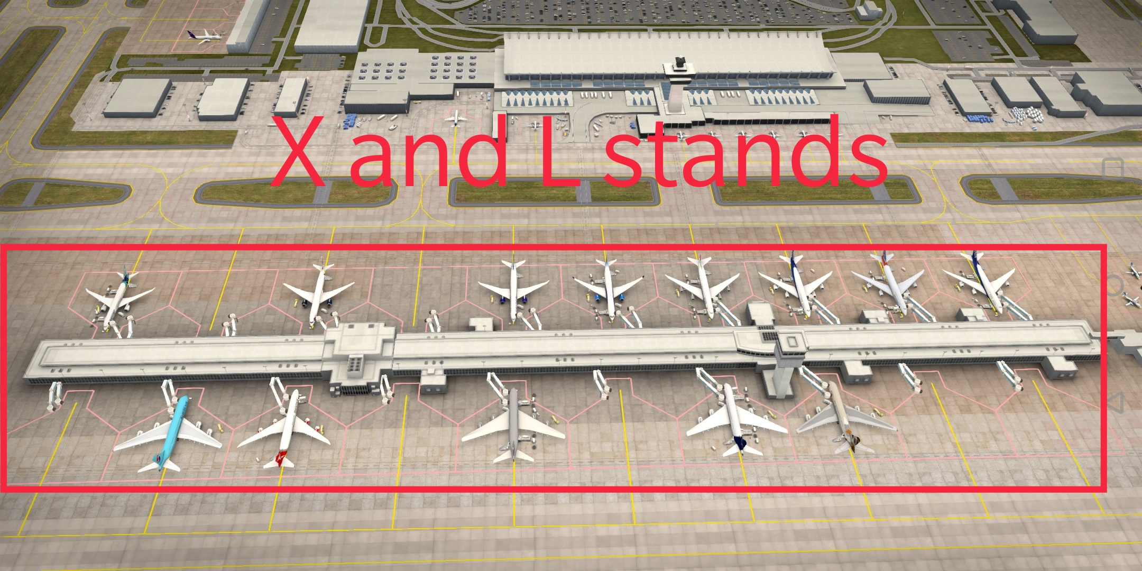
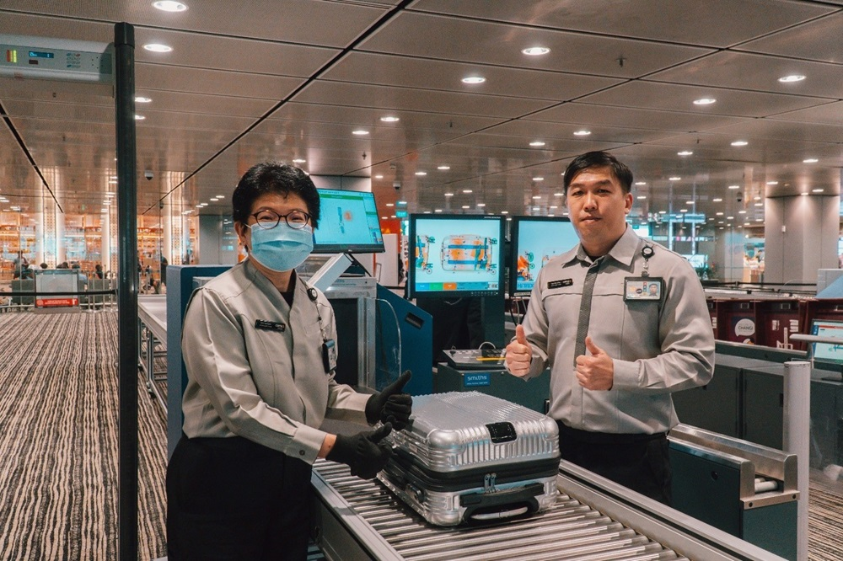
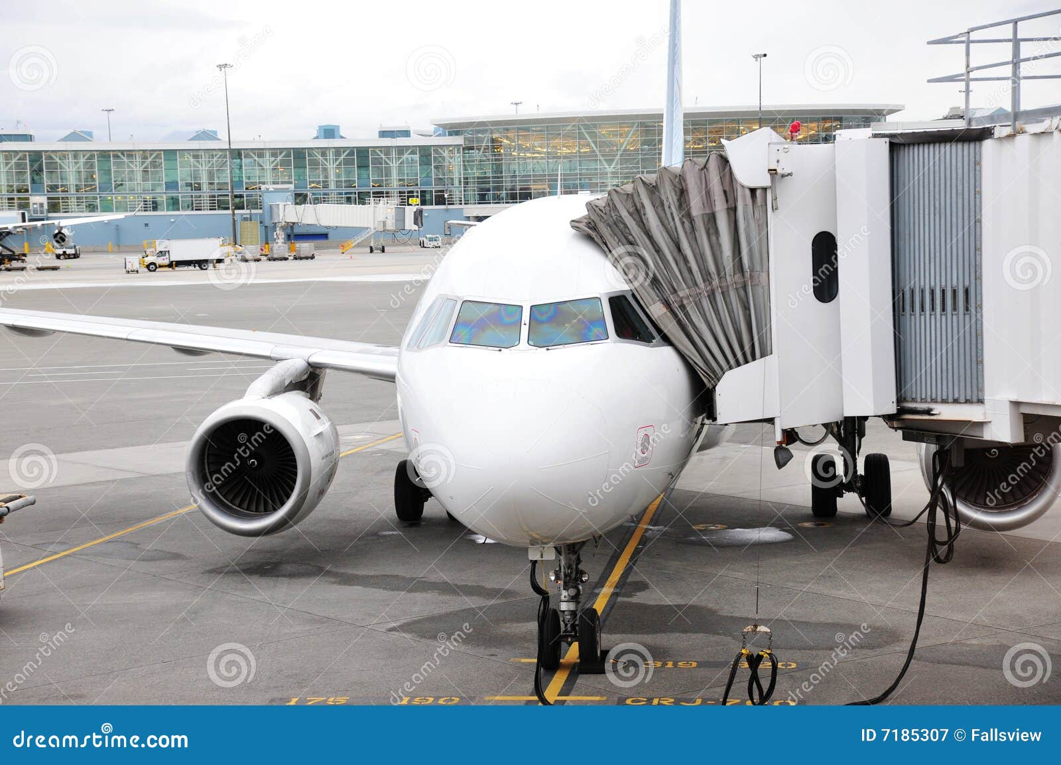
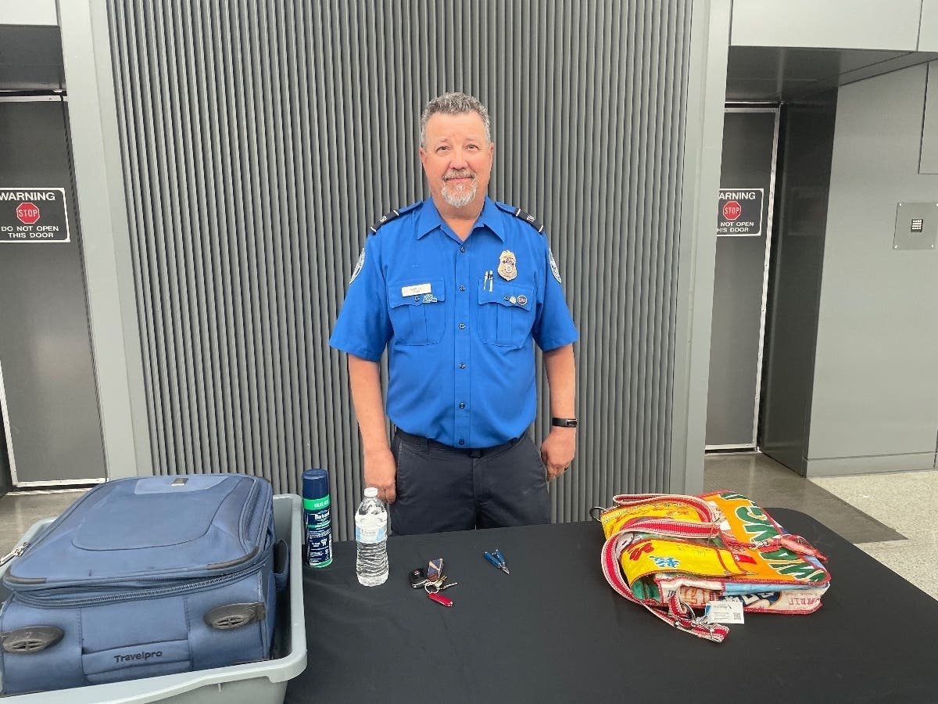


Slide 6
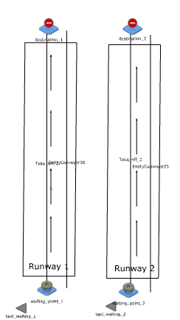
Destination function, removes the aircraft when it flies
When planes land, they will come down the runway simulating realism
Planes within these delegated queues will use their specific runway.
This will facilitate the take-off procedures and give realism to showcase how long it takes for the aircraft to take off

Slide 7

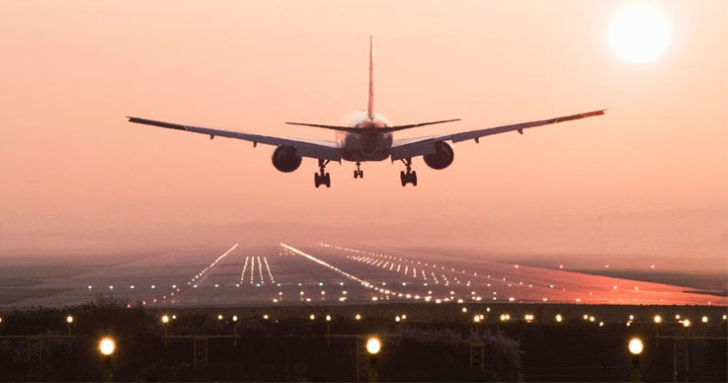

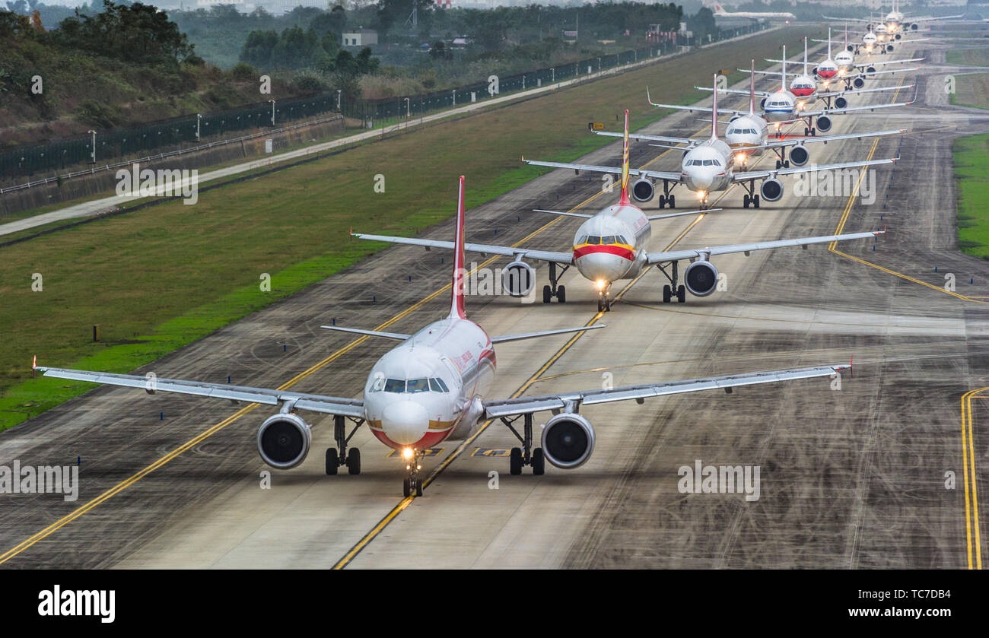

Slide 8
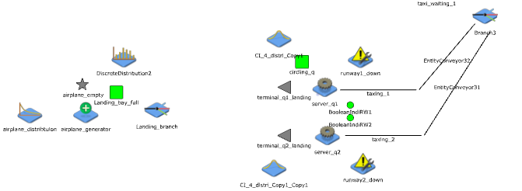
If both runways are down, and airspace is congested, threshold will hit closing new aircraft generation
As planes come in, they will be send to which runway has least aircrafts circling
Will only generate aircrafts if landing bay isn’t full
As planes (full of passengers) taxi for take-off, they will go to the runway queue with the least number of aircraft waiting
Aircraft generator with its distribution
As planes get passengers, they will be sent to this conveyer, signalling them taxing to runway queue
If the runway is currently servicing a jet, plane will circle around the airport
In a real-world, runways will be unusable sometimes, so runway will have a probability of failing with ranging down times.

Slide 9
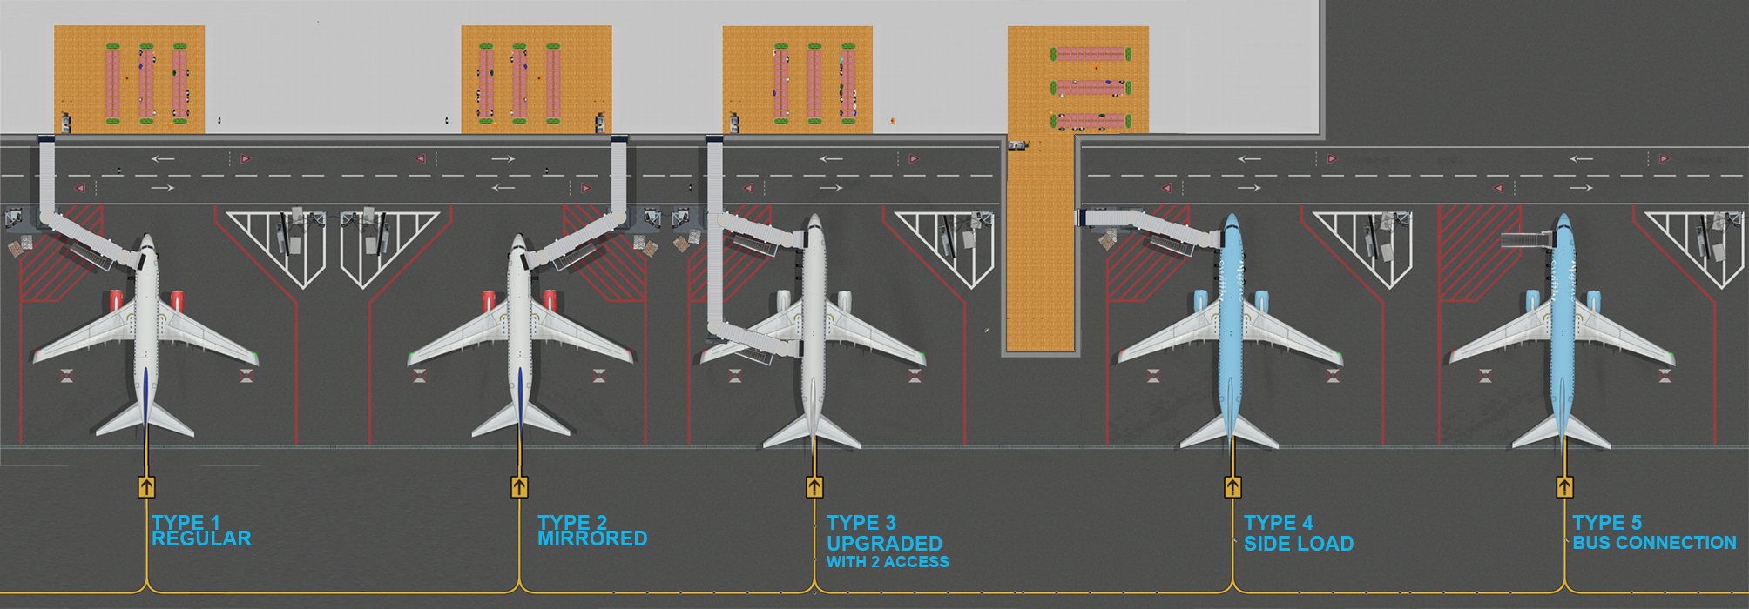

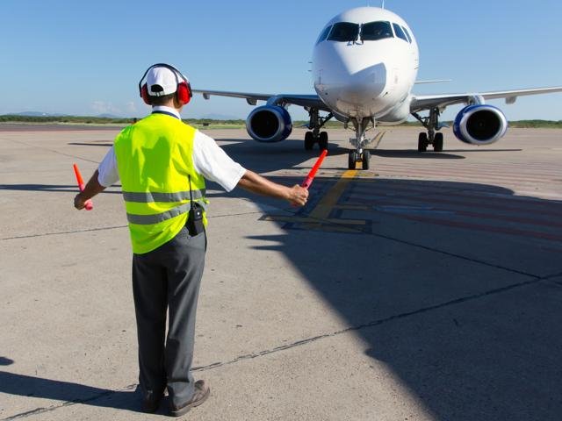
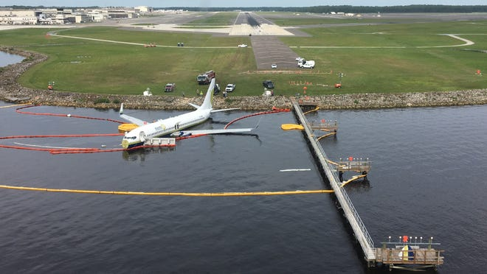

Slide 10
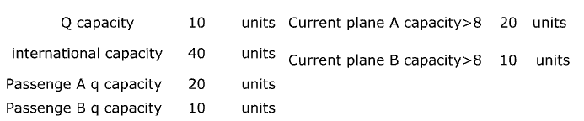
Limit control for number of people that the check-in counters collectively can serve
Limit control for international queue
Plane A has a different capacity than B as plane A is more like commercial jet (with higher capacity) and B might be a different kind of planes
Plane B has a different capacity than B as plane A is more like route specific jet (with lesser capacity)
Q capacity controls from gates A and B

Slide 11
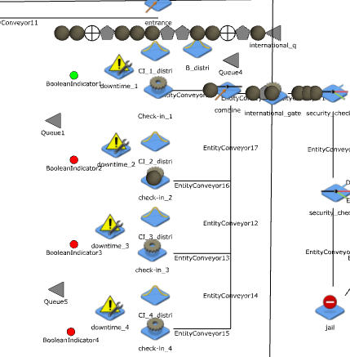
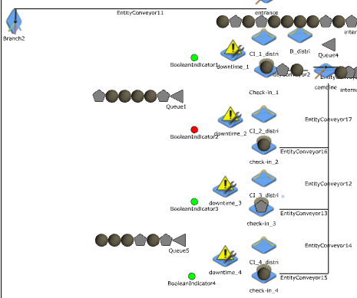
Step 1a
generate passengers if all conditions are not violated
Step 2a
Clear passengers from check in to international queue -> international_gate

Slide 12
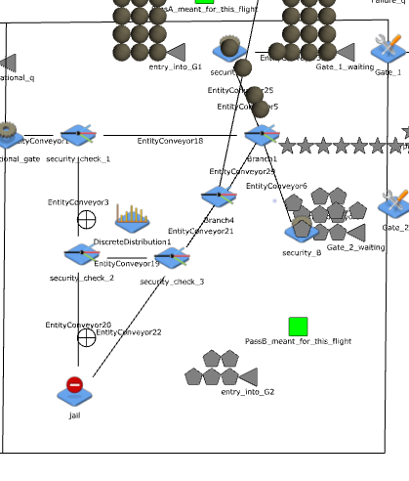
Step 3a
Passengers clear international gate, as queue for international gate is too long, airport is closed.
Step 4a
Passengers clear the security, while terrorist gets caught.
Passengers get ushered to either Gate A or Gate B.
Passengers line up to get security checked
As conditions for planes boarding and take off is met, passengers get ferried away

Slide 13
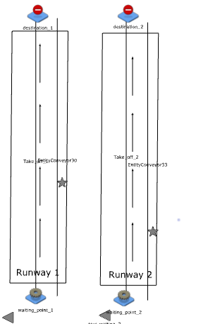
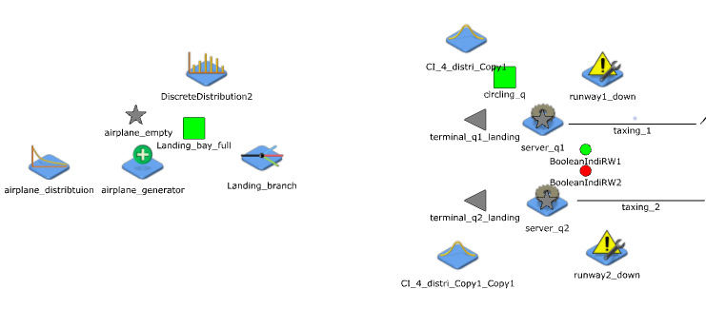
Step 1b
Generate airplanes
Step 3b
As planes conditions are met, they take off
Step 2b
As planes come in, they land if the servers (runways) can handle them

Slide 14
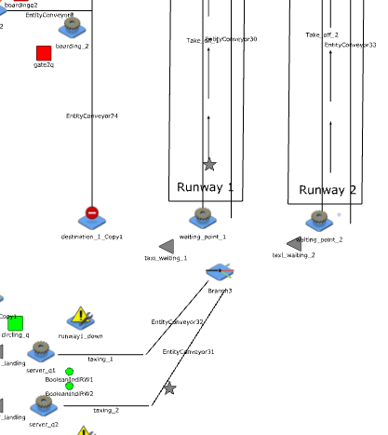
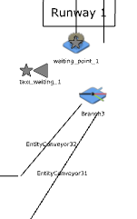
Step 4b
As planes are ready to take off, it will be sent to either 31 or 32, get in queue for take-off. Once runway is ready, plane take-offs
This shows how it will look when planes are waiting in line for another plane to take off

